Slide 1


DSGE MODEL for national bank of poland
Lecturer: Dr. Karolina Sobczak
Students: 1. Le Thi Ngoc
2. Nguyen Thi Kim Phuong
3. Trinh Ngo MinhTruong
4. Nguyen Tu Anh

Slide 2
CONTENT
INTRODUCTION
MODEL DEVELOPMENT PROCESS
THE STRUCTURE OF NECMOD MODEL
NECMOD MODEL
CONCLUSION

Slide 3
INTRODUCTION
NECMOD: The main forecasting model of the National Bank of Poland (NBP) from 2008 till now. ECMOD: the first origins of NECMOD that was employed to prepare regular inflation projections at the NBP from 2005 to the begining of 2008, and then they developed ECMOD to be NECMOD.
NECMOD is a structural macroeconometric model designed to describes the Polish economy to publisded the inflation and GDP projection.
- Many banks and institutions used NECMOD to forecast and draft state budget for 2022, such as Santander Bank Polska, Union of Entrepreneurs and Employers (ZPP),…

Slide 4
II. MODEL DEVELOPMENT PROCESS
YEAR | CONTENT | COMMENTS
2005 | Estimation of ECMOD model | This is the orginal model of NECMOD model
2008 | Developed ECMOD to be NECMOD | The first version of the NECMOD which is developed from ECMOD model
2009 | Re-estimation of NECMOD model, and NBP have been using this model till now | Changes to the foreign trade block
2010 | Re-estimation of NECMOD model | Chages to prices block, new corporate investment equation
2011 | Re-estimation of NECMOD model | Chages to prices block, including the hysteresis
2012 | Re-estimation of NECMOD model | Respecification of labour participation block

Slide 5
III. THE STRUCTURE OF NECMOD MODEL
3.1. THE STRUCTURE OF ORGINAL MODEL (ECMOD)
3.2. THE STRUCTURE OF NECMOD MODEL

Slide 6
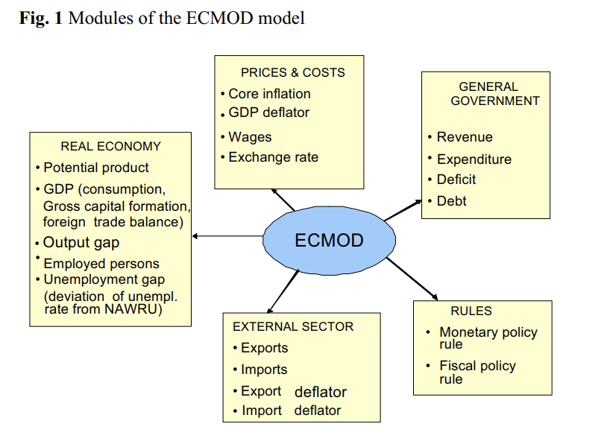
3.1. THE STRUCTURE OF ORGINAL MODEL (ECMOD)
ECMOD model has over 100 equations

Slide 7
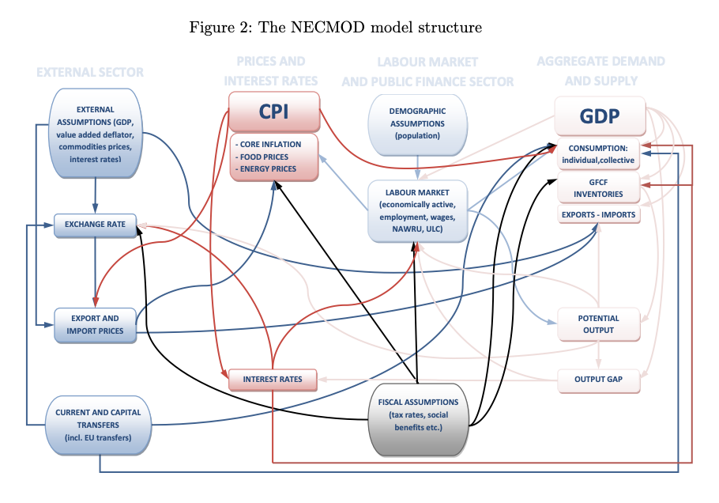
3.2. THE STRUCTURE OF NECMOD MODEL
NECMOD model has 276 equations and 369 variables

Slide 8
IV. NECMOD MODEL
4.1. NECMOD MODEL _ 2008
4.2. NECMOD MODEL _ 2009
4.3. NECMOD MODEL _ 2010
4.4. NECMOD MODEL _ 2011
4.5. NECMOD MODEL _ 2012

Slide 9
4.1. NECMOD MODEL _ 2008
4.1.1 Overview
4.1.2. Characteristics of NECMOD model
4.1.3 Main blocks of NECMOD model
4.1.4. Equations
4.1.5 Model’s impulse response functions
4.1.6 Summary

Slide 10
4.1. NECMOD MODEL _ 2008
4.1.1 Overview
BNP bank changed ECMOD model to NECMOD model, because changing in economy in 2004, and there are some main arears changed:
Labour market: high volatility of unemployee rate and migration flows
Housing market: significant increasing prices of houses
Oil shock and food price rise
Fiscal reforms and change in regulations: changes in tax; energy market deregulation
Data:
Main source: national accounts
Information about labour market (LFS data), prices of consumer goods (CPI basket), financial data from BNP
The times series for the period of 1995 - 2007

Slide 11
4.1. NECMOD MODEL _ 2008
4.1.2. Characteristics of NECMOD model
NECMOD 2008 reflects the evolution of the economy over the past few years
The richer forecasting experience
NECMOD is hybrid model and its long-term stability have been preserved
The supply side of the economy has been extended and elaborated in greater detail (potential product, equilibrium unemployment rate, equilibirum rate of economic activity, equilibrium exchange rate)
Potential simulation posibilities can provide answers to many question:
Impact of fiscal changes
Structural fund
Emigration

Slide 12
4.1. NECMOD MODEL _ 2008
4.1.3. Main blocks of NECMOD model
NECMOD_2008
1.Production
2. Demand
3. Labour
4. Household expenditure
5. Prices
6. External
7. Interest rate
1.1. GDP
1.2. Corporate capital
7.1. Long - term
7.2. Short - term
2.1. Private investment
2.2. Demand on labour
6.1. Exports
6.2. Imports
6.3. Nominal exchange rate
3.1. Economic activity
3.2. Supply of loan
3.3. Wage
3.4. Unemployment rate
5.1. Prices
5.2. Deflation
4.1. Individual consumption
4.2. Residential investment
4.3. Assets deflator

Slide 13
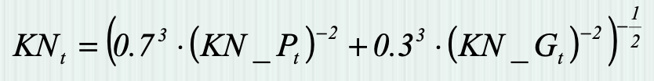
4.1.4. NECMOD MODEL _ 2008
Sectors | Equations | Variables
1.Production 1, Core: production function 2, Productive capital includes private and public productive capital 3, GDP determined by production fuction |  | gdp: GDP tfp_trend: total factor productivity emp: employment kn: productive capital
 |  | KN_P: net corporate productive capital KN_G: net public productive capital
 |  | gdppot: potential capital LF: labour force NAWRU: equilibirium unemployment rate

Slide 14
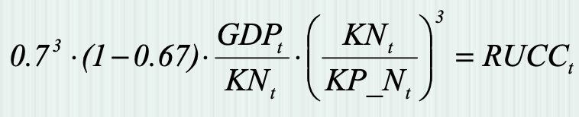
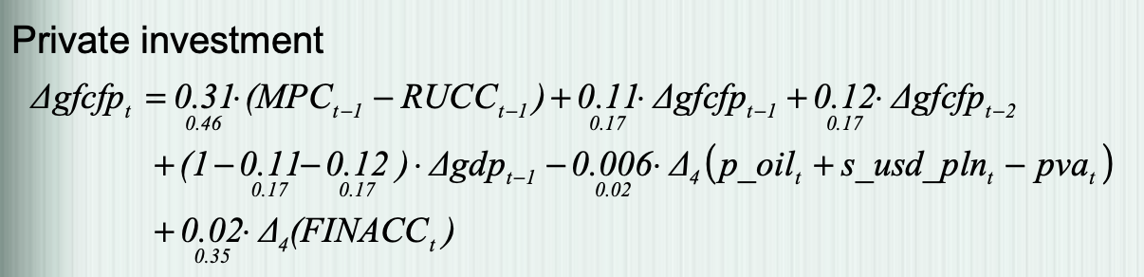
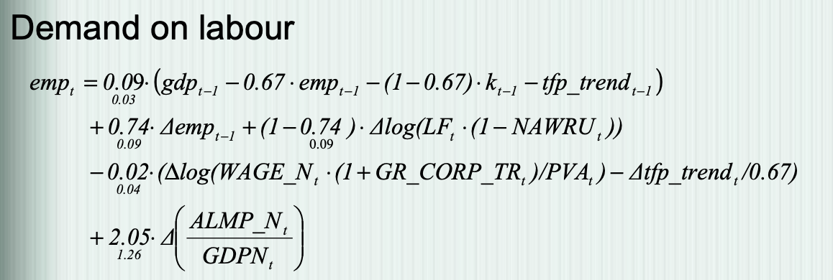
Sectors | Equations | Variables
II. Demand for production 1, Two types of productive investment: Private investment determined by the equality of marginal productivity of private capital and its real user cost; Public investment for general government 2, Demand on labour depends on active labour market policy, labour costs, and effective labour supply | Condition for private investment: | RUCC: real user cost of capital KP_N: corporate productive capital
 |  | gfcfp: investment in corporate productive capital MPC: marginal product of private capital p_oil: oil price s_usd_pln: USD/PLN exchange rate pva: value added deflator FINACC: contribution of enterprises’ disposable income to total national income
 |  | WAGE_N: average wage in the economy GR_CORP_TR: effective tax rate of social contribution paid by emloyer PVA: gross value added deflator ALMP_N: active labour market policy expenditures GDPN: nominal GDP

Slide 15
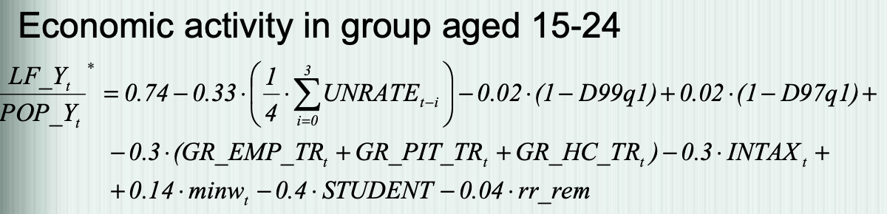
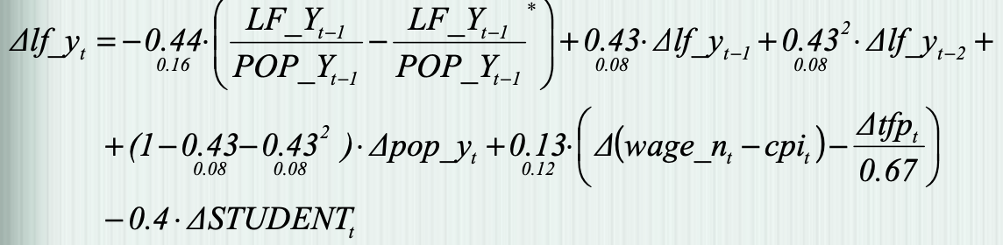
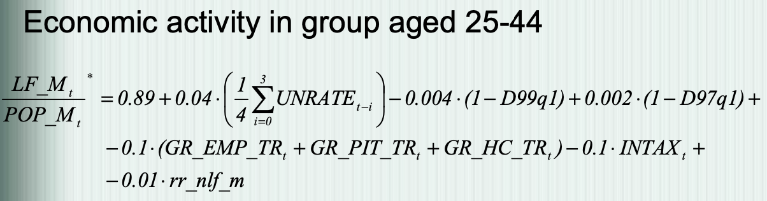
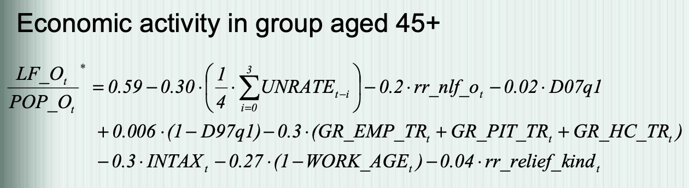
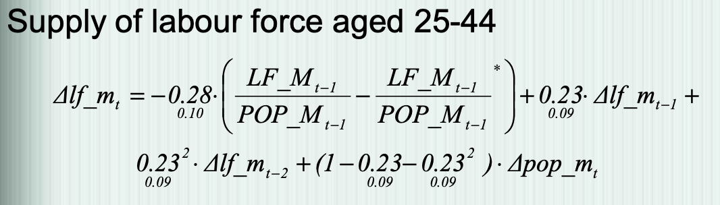
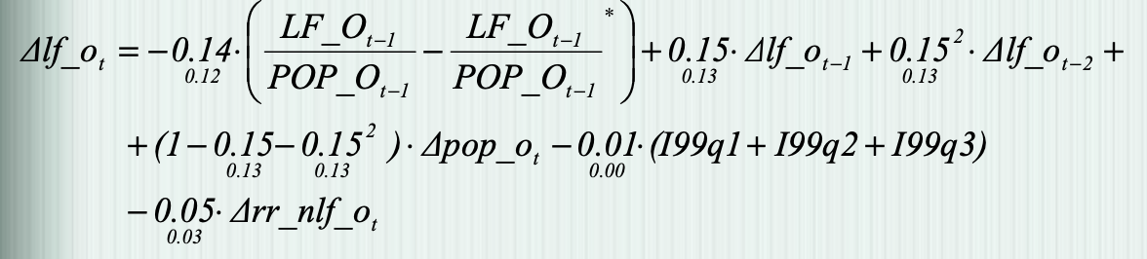
Sector | Equations | Variables
III. Labour market 1, Model divided in 3 groups of population: (15;24); (25;44); and over 45 2, Economic activity has: Negative impact of unemployment Negative impact of taxes Negative impact of alternative sources of income |  | LF_Y: labour force aged 15-24 POP_Y: population aged 15-24 UNRATE: unemployment rate D99q1: the impact of changes in healthcare system D97q1: the impact of changes in unemployment benefit system GR_EMP_TR: effective tax rate of social contribution paid by employees GR_PIT_TR: effective rate of PIT GR_HC_TR: effective rate of heath insurance INTAX: effective rate of indirect taxes MINW: minimal to average wage ratio RR_REM: ratio of remittance to wage fund STUDENT: share of fulltime students in population aged 15-24
 | Supply of labour force aged 15-24 | WAGE_N: average nominal wage in the economy tfp: total factor productivity

Slide 16
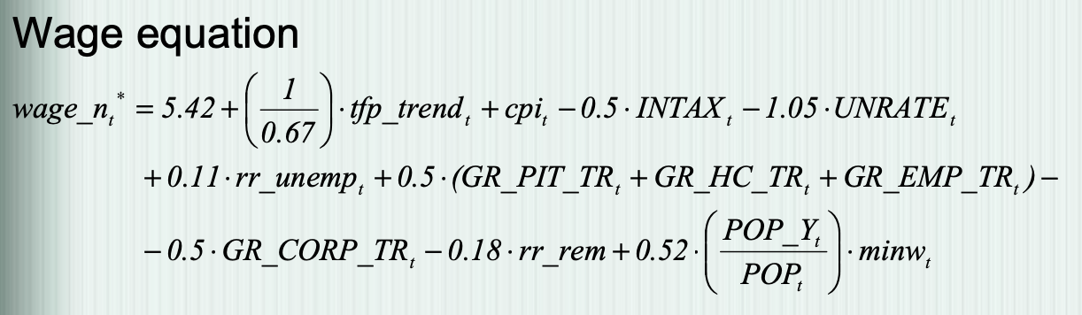
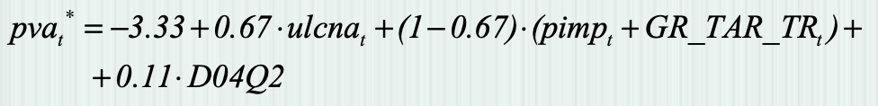
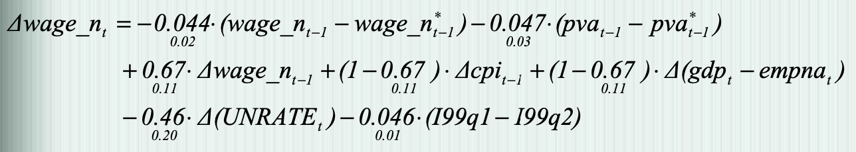
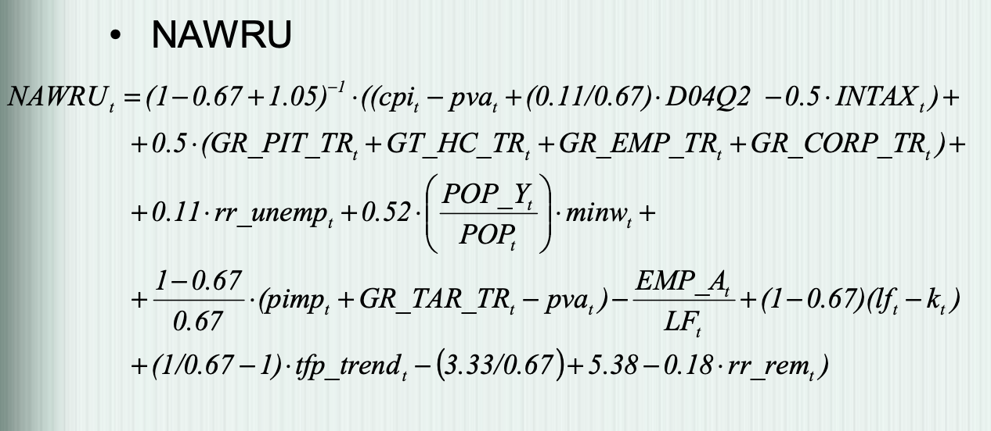
Sector | Equations | Variables
III. Labour market 3, Wage equation: The wage curve presents the relationship between the desired real wage of employees and their actual remuneration from work. |  | cpi: consumer price index UNRATE: unemployment rate RR_UNEMP: replacement ratio of unemployment benefits RR_REM: ratio of remittances to wage fund POP_Y: Population aged 15-24 POP: total population MINW: minimum to average wage ratio
 | Price equation | pva: value added deflator ulcna: non-farm unit labour cost pimp: prices of imported goods GR_TAR_TR: effective rate of import duties
 |  | NAWRU: unemployment equilibrium rate

Slide 17
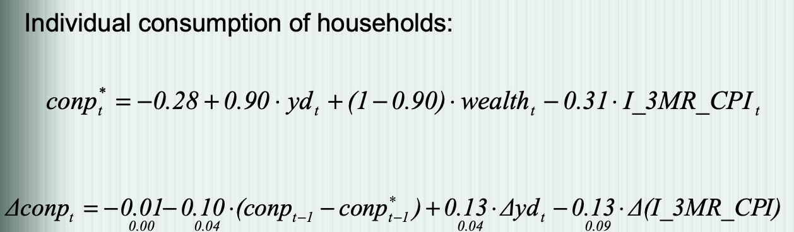
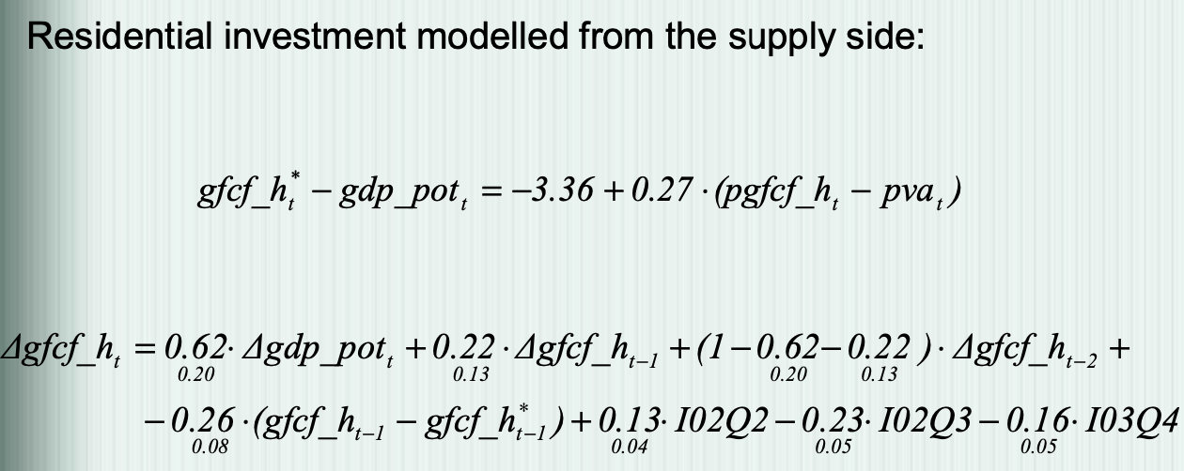
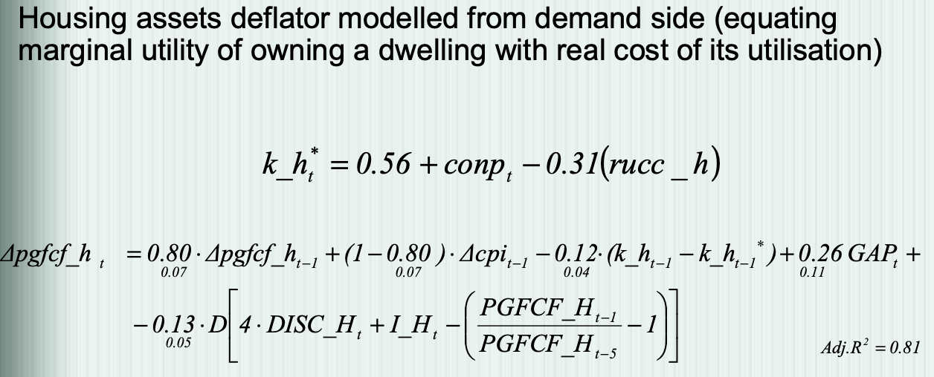
Sector | Equations | Variables
IV. Household expenditure 1, Modelling of households’ spending derived from life cycle theory and permanent income theory 2, Wealth = Private productive capital + Residential capital + Public debt + Net foreign assets 3, Residential investment modelled from the supply side whereas housing assets deflator modelled from the demand side - it ensures that in response to demand shock, the reaction of prices outpaces the reaction of investment |  | conp: individual consumption of households yd: real disposable income of households I_3MR_CPI: real 3-months interest rate wealth: wealth of households
 |  | gfcf_h: gross residential investment gdp_pot: potential GDP pgfcf: price of housing assets pva: value added deflator
 |  | cpi: consumer price index k_h: residential capital stock GAP: output gap DISC_H: depreciation rate of residential capital I_H: interest rate on housing loans rucc_h: real user cost of residential capital

Slide 18
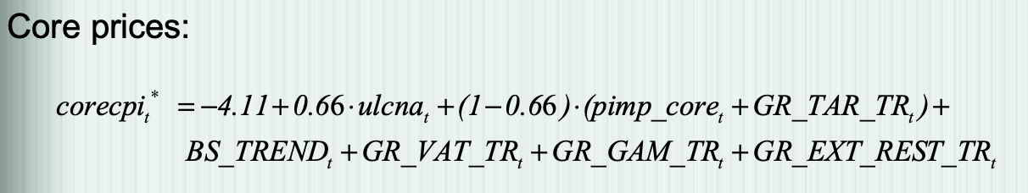
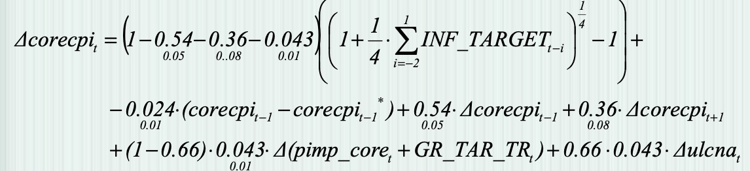
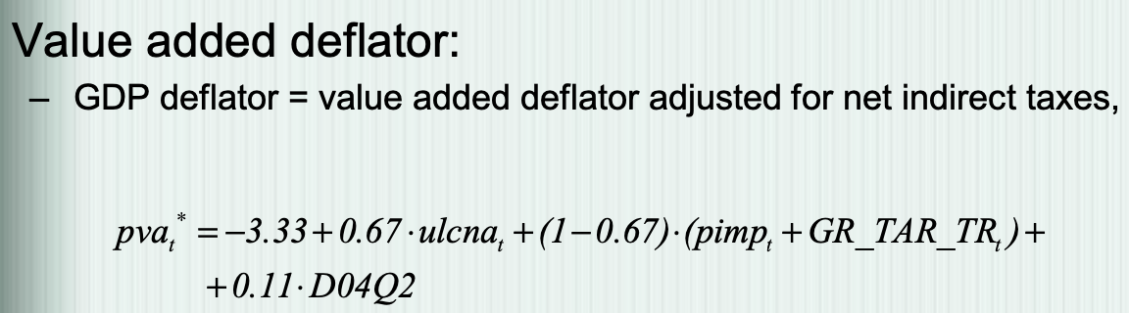
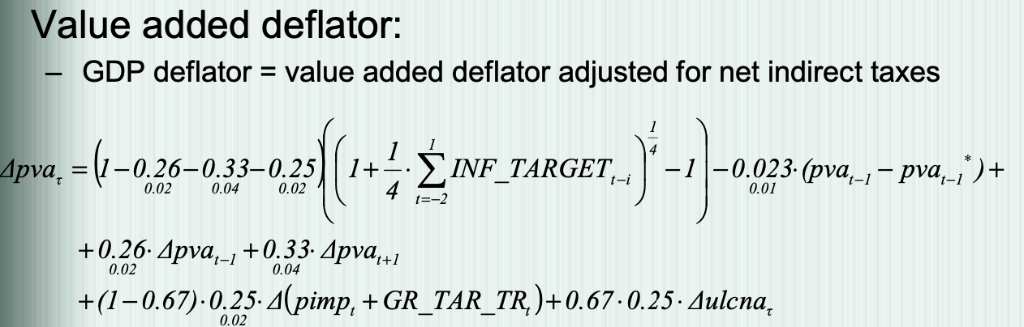
Sector | Equations | Variables
V. Prices 1, Prices of consumer goods depends on CPI net of food and energy prices. 2, Producer prices depends on value added deflator (it is main index of producer prices) |  | corecpi: consumer price index net of prices of energy products and food ulcna: non-farm unit labour cost Pimp_core: prices of imported goods excluding prices of oil and natural gas BS_TREND: trend GR_VAT_TR: effective VAT rate GR_GAM_TR: effective gambling tax rate GR_EXT_REST_TR: effective rate of other (non-energy) excise taxes
 |  | INF_TARGET: inflation target
 |  | PVA: value added deflator GR_TAR_TR: effective rate of import duties
 |  | INF_TARGET: inflation target

Slide 19
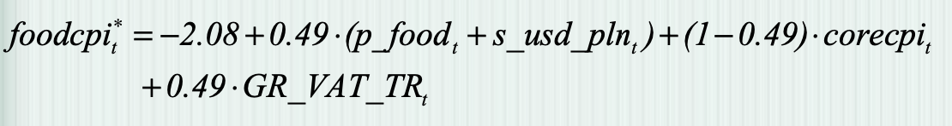
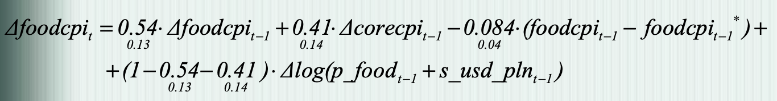
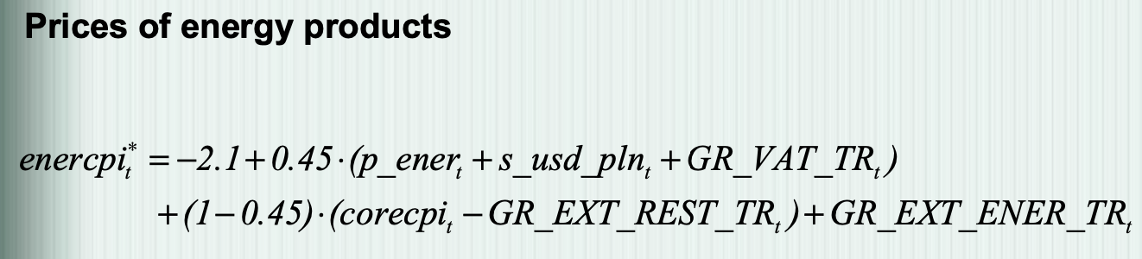
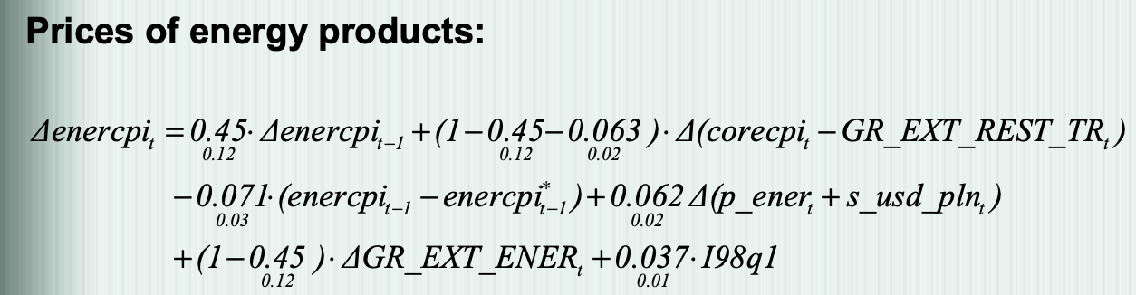
Sector | Equations | Variables
V. Prices 3, Food and energy products prices are adjusted by experts in the projection horizon | Food prices | foodcpi: food price index p_food: world price index of raw agriculture commodities s_usd_pln: usd/pln exchange rate adjusted for norminal convergence effect GR_VAT_TR: effective VAT rate
 |  | foodcpi: food price index corecpi: consumer price index net of prices of energy products and food p_food: world price index of raw agriculture commodities s_usd_pln: usd/pln exchange rate adjusted for norminal convergence effect
 |  | enercpi: enerdy product price index p_ener: world raw energy commodities price index GR_EXT_REST_TR: effective exercise tax rate-other goods GR_EXT_ENER_TR: effective excise tax rate – energy products

Slide 20
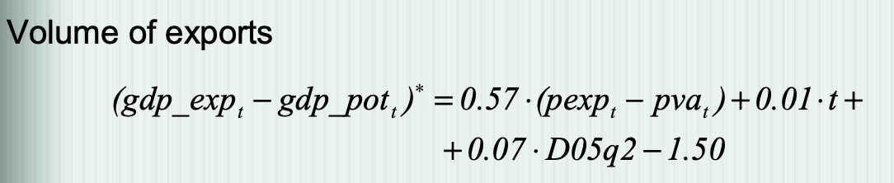
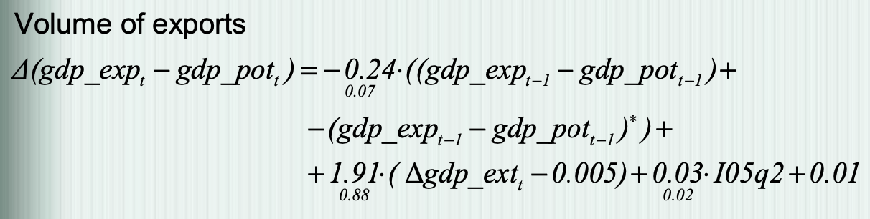
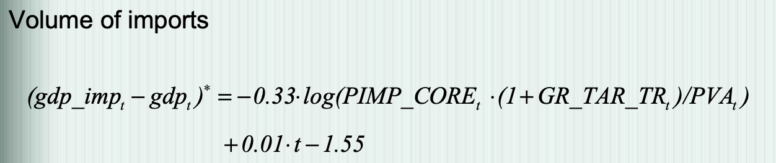
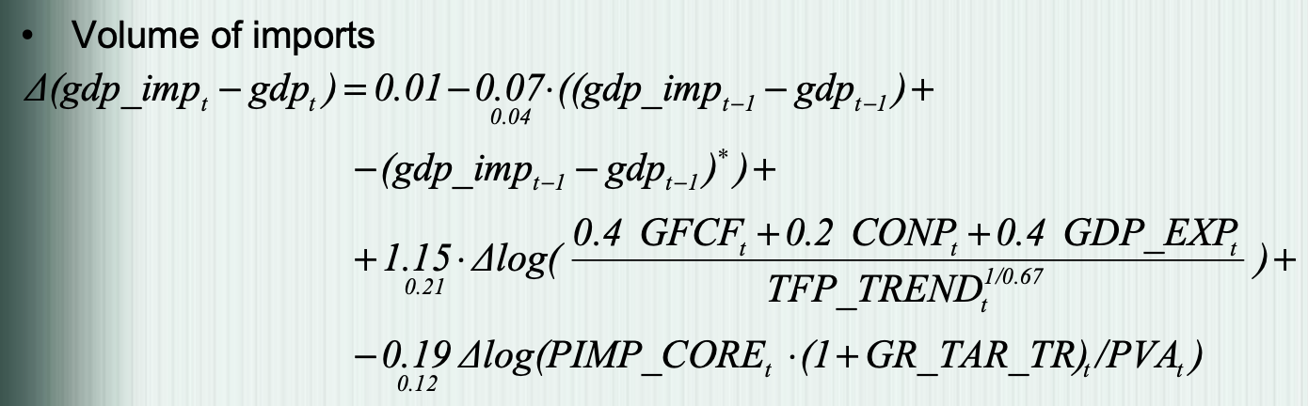
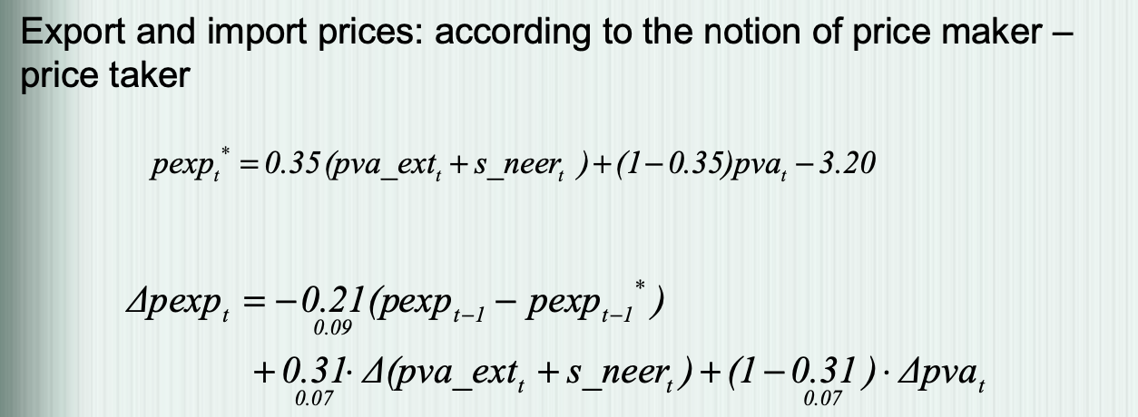
Sector | Equations | Variables
VI. External 1, Volume of exports builded from the supply side in the long run and the demand side in the short run 2, Volume of imports modelled from the supply side |  | gdp_exp: volume of exports Gdp_pot: potential GDP Pexp: deflator of exports Pva: value added domestic deflator T: trend connected with gradual integration of Polish economy
 |  | gdp_exp: external product
 |  | gdp_imp: volume of imports pimp_core: prices of imported products excluding oil and gas prices GR_TAR_TR: effective rate of duties
 |  | GFCF: total gross fixed capital formation CONP: individual consumption TFP_TREND: total factor productivity
 |  | pva_ext: external value added deflator s_neer: nominal effective exchange rate adjusted for nominal convergence effect

Slide 21
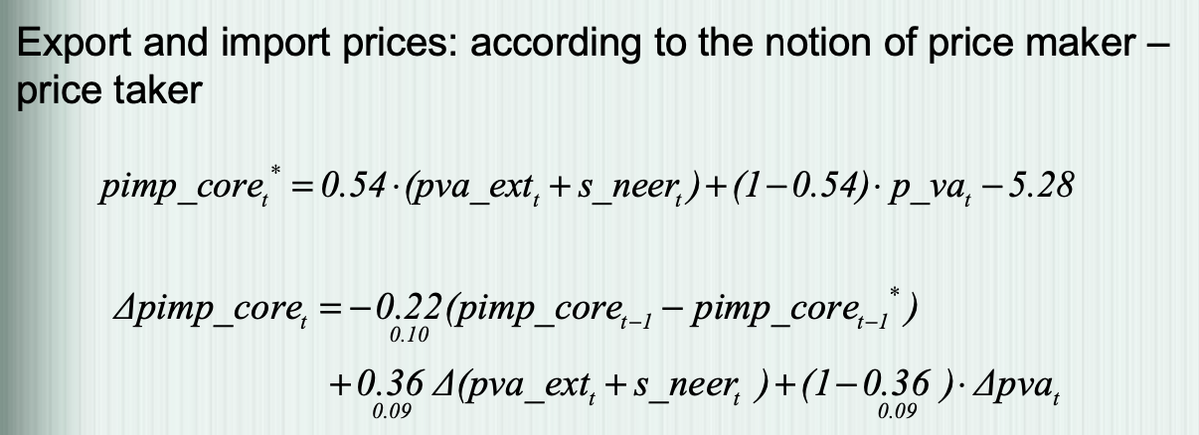
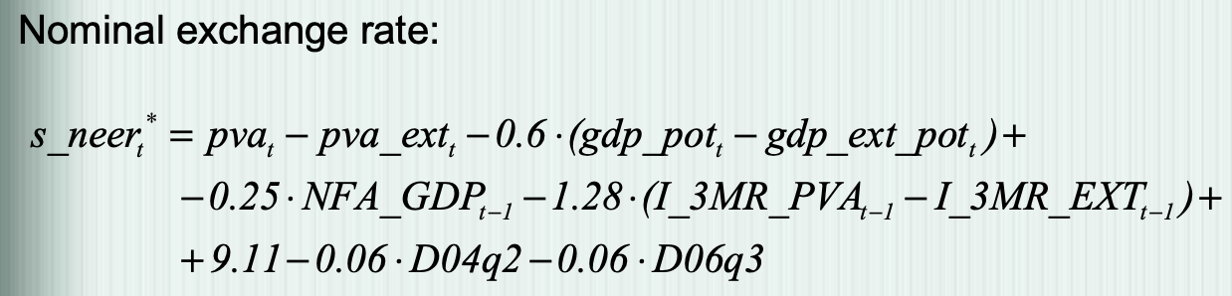
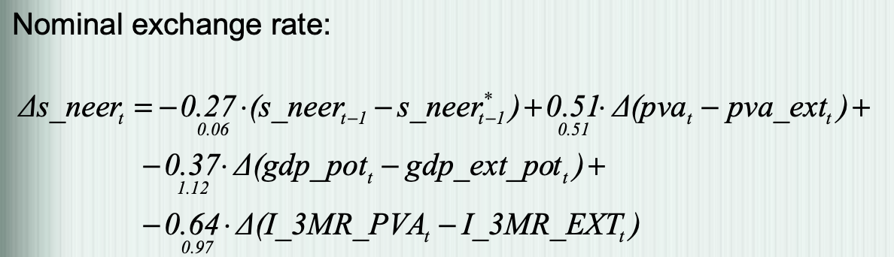

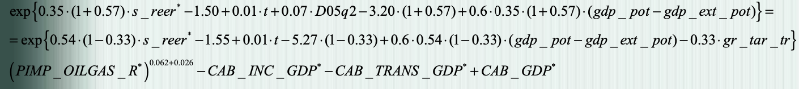
Sector | Equations | Variables
VI. External 3, Export function is function of relative export prices, potential GDP and external demand 4, Imports as function of relative import prices, GDP, domestic demand |  | pimp_core: prices of imported products excluding oil and gas prices pva_ext: external value added deflator s_neer: nominal effective exchange rate adjusted for nominal convergence effect Pva: value added domestic deflator Gdp_pot: potential GDP
 |  | gdp_ext_pot: external potential GDP I_3MR_PVA: real 3months interest rate I_3MR_EXT: external real interest rate NFA_GDP: net foreign assets in relation to GDP
 |  | GR_TAR_TR: effective rate of duties PIMP_OILGAS_R: relative prices of imported commodities CAB_INC_GDP: income account in relation to GDP CAB_TRANS_GDP: balance on current transfers in relation to GDP CAB_GDP: current account balance in relation to GDP

Slide 22


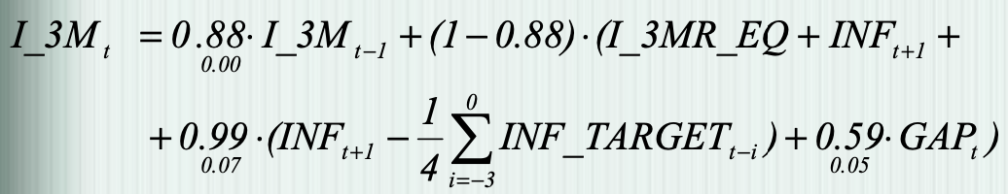
Sector | Equations | Variables
VII. Interest rates: 1, All real interest rates deflated with future inflation 2, Long-term interest rates adjustment for risk premium (based on public finance sector, inflation expectations) 3, Short-term interest rates: estimated Taylor’s Rule |  | I_5Y: 5-year interest rate I_3M: 3-months interest rate G_BALANCE_GDP: general government balance in relation to GDP
 |  | I_3M_EQ: real interest rate in long-term equilibrium INF: CPI inflation INF_TARGET: inflation target GAP: output gap

Slide 23
4.1. NECMOD MODEL _ 2008
4.1.4. Model’s impulse response functions
Monetary impulse
Exchange rate impulse

Slide 24
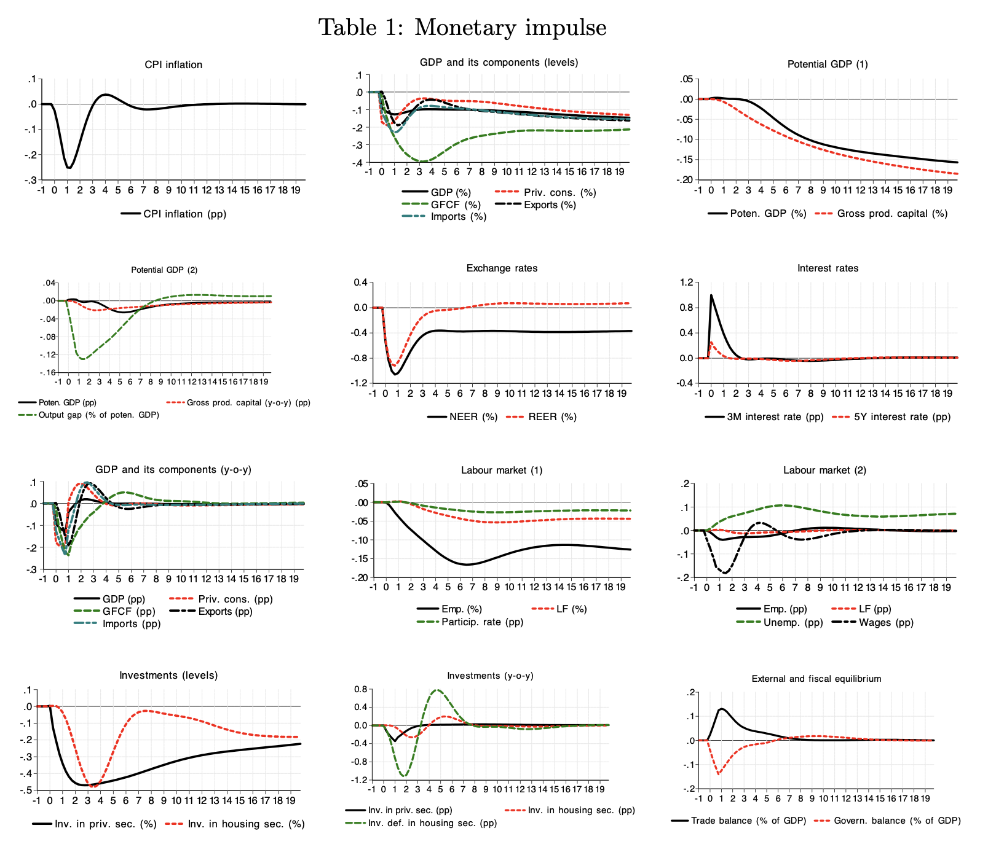
4.1. NECMOD MODEL _ 2008
4.1.4. Model’s impulse response functions
Monetary impulse
The interest rate shock in fluences the economy through 5 major channels:
The exchange rate channel
The substitution-effect channel
The cost of capital channel
The income and cash-flow channel
Wealth channel
- Impulse reaction functions of key macrocategories are given in Table 1

Slide 25
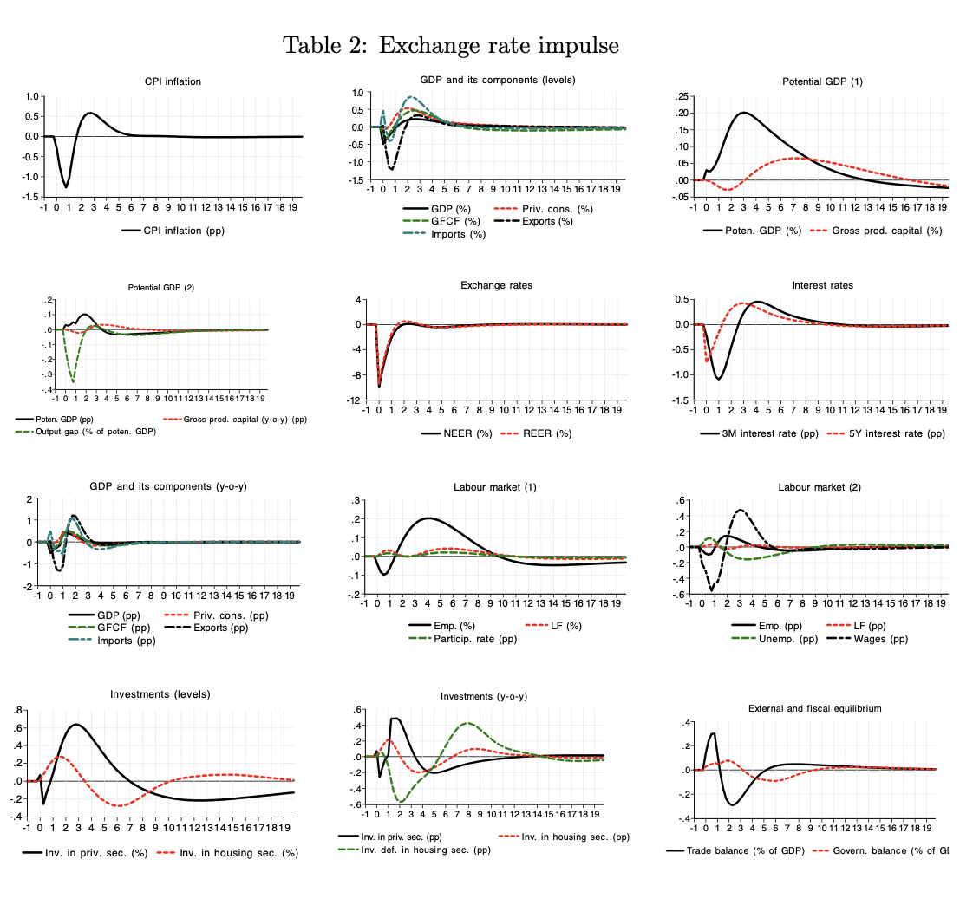
4.1. NECMOD MODEL _ 2008
4.1.4. Model’s impulse response functions
(2) Exchange rate impulse
An appreciation of the exchange rate reduces import and export prices → decreases production cost, such as the stronger zloty passes through into lower food and energy prices
Higher import price and lower profit, net export and the current account balance deteriorate
After the current account balance worsening, moderation of the appreciation trend in the exchange rate already sets in.

Slide 26
4.1. NECMOD MODEL _ 2008
4.1.6 Summary
The BNP’s method in 2008
Advantages and disadvantages

Slide 27
4.1. NECMOD MODEL _ 2008
4.1.6 Summary
The BNP’s method in 2008
In this method, the width of the fan chart is consistnet with the past errors of the ECMOD model, at the same time depending on the current uncertainty assessment of exogenous variables
The procedure of constructing the fan charts consist of the following steps:
Step 1: Determining the distributions of historical forecast errors
Step 2: Simulation of paths of exogenous variables
Step 3: Simulations from the NECMOD model
Step 4: Determining the current uncertainty concerning GDP and inflation

Slide 28
4.1. NECMOD MODEL _ 2008
4.1.6 Summary
(II) Advantages and disadvantages:
Advantages:
With of the fan charts is consistent with the expert-adjusted, historical forecast errors from the ECMOD model
Reflecting changes in uncertainty between forecasting rounds
Fan chart is constructed under the assumption of exogenous monetary policy
Revisions of variables (national accounts) are accounted for
Method is flexible and can be modified/extended easily
Disadvantages:
Changes in endogenous uncertainty are not accounted for
Consequences of improvement of the model and expert adjustments are not accounted for

Slide 29
4.2. NECMOD MODEL _ 2009
4.2.1 Overview
4.2.2. Characteristics of NECMOD model
4.2.3 Main blocks of NECMOD model
4.2.4. Equations
4.2.5 Model’s impulse response functions
4.2.6 Summary

Slide 30
4.2. NECMOD MODEL _ 2009
4.2.1 Overview
An update of the structural macro econometric model of the Polish economy NECMOD. The present version of NECMOD was estimated on the data covering a period from 1995 to 2008. There are some main changes:
Re-estimation on the data sample from 1995 to 2008
The block of external sector with exchange rate determination derived from the taste-for-variety theory.
More precise definition of household wealth,
Higher level of fiscal sector sophistication,
Refurbished specification of dynamics of inventories
Data:
Main source: national accounts
Information about labour market (adjusted for data bias of LFS), General government (ESA methodology), prices of consumer goods (CPI basket), financial data from BNP.
Notes:
The model in 2009 presents an update of the structural macroeconometric model of the Polish economy NECMOD. The updated version of the model is, similarly decessor, used at the National Bank of Poland for forecasting and policy simulation exercises.
The present version of NECMOD was estimated on the data covering a period from 1995 to 2008.
There are some main changes:
Reestimation on the data sample from 1995 to 2008
The block of external sector with exchange rate determination derived from the taste-for-variety theory.
More precise definition of household wealth,
Higher level of fiscal sector sophistication,
Refurbished specification of dynamics of inventories
Data:
Main source: national accounts
Information about labour market, General government, prices of consumer goods, financial data from BNP

Slide 31
4.2. NECMOD MODEL _ 2009
4.2.2. Characteristics of NECMOD model
The characteristics of the model has not changed significantly since 2008

Slide 32
4.2. NECMOD MODEL _ 2009
4.2.3. Main blocks of NECMOD model
10. Long-term properties
1.
Production
2. Households
NECMOD_2009
9.
The monetary authority and interest rate
3.
Labour supply
8.
Fiscal section
4.
Labour market
7.
Costs and prices
5.
External section
6.
Aggregate demand and supply

Slide 33
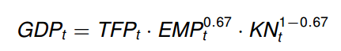
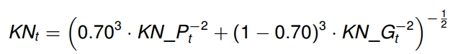
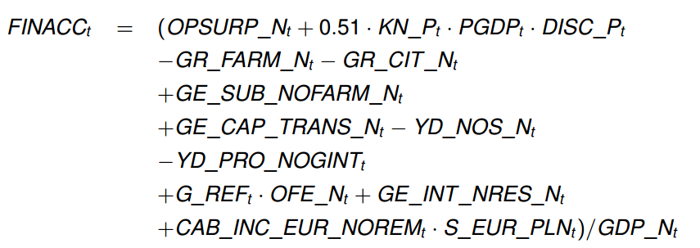
4.2.4. NECMOD MODEL _ 2009
Sectors | Equations | Variables
1.Production |  | GDP: gross domestic product TFP: total factor productivity EMP: employment KN: net productive capital
 |  | KN_P: net corporate capital KN_G: net public capital
 |  | FINACC - corporate disposable income share in GDP GR_FRAM_N - GG revenues from social security contributions paid by farmers, GR_CIT_N - taxes on income or profits of firms including holding gains, YD_NOS_N - nominal income of households from the operating surplus, ….
Notes:
Production function constitutes the core of the supply inputs (labour and productive capital) with a Cobb-Douglas technology
KN_P and KN_G Corporate and public capital, accumulated in line with perpetual inventory idea are bundled into productive capital under assumption of imperfect substitutability (KNt).
After some transformations, The financial position of enterprises serves as proxy for financial accelerator effect Public investments evolve with nominal GDP changes.
Finally, short-run variation of inventories is tied to changes in the level of sales.

Slide 34
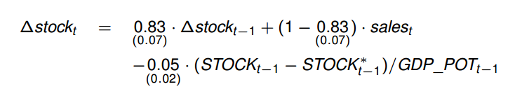
4.2.4. NECMOD MODEL _ 2009
Sectors | Equations | Variables
1.Production |  | Adjusted R² = 0.69 S.E. of equation = 0.006 LM test (p-value) = 0.13 Estimation period: 1996q1 - 2008q4
Notes:
Let move to section 2: Households’ sector

Slide 35
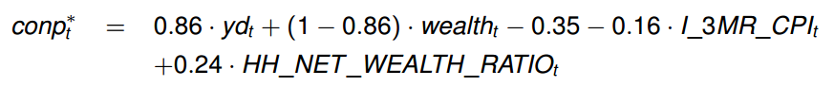
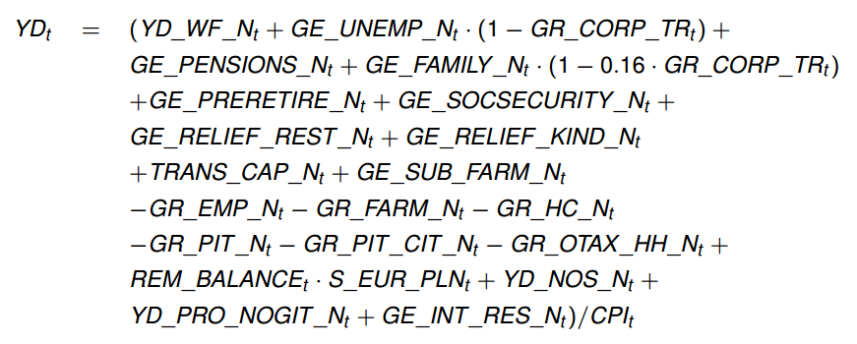
Sectors | Equations | Variables
II. Households’ sector |  | CONP - individual consumption. YD - real disposable income, WEALTH - wealth, I_3MR_CPI - real 3-month interest rate (deflated with CPI). HH_NET_WEALTH_RATIO - ratio of a difference between financial assets and liabilities of households to the nominal value of wealth,
 |  | YD_N - total nominal disposable income of households, YD_NOS_N - nominal income of households from the operating surplus, YD_PRO_N - nominal income of households from property, YD_WF_N - nominal wage bill, GE_UNEMP_N - general government (GG) expenditures on unemployment benefits ….
Notes:
Consumption: - modelled in line with the permament income hypothesis, - the permanent income proxied by the weighted average of wealth and disposable income of households, - set of explanatory variables extended to include households’ net wealth ratio (difference between their assets and liabilities normalized by nominal wealth) to capture the effects of an increase in households’ debt at the end of the sample period, You can see the first equation with …..
the second equation show that Households' disposable income is a sum of remuneration from work (aggregate wages) plus social security and social assistance benefits net of income and property taxes and social security contributions. Disposable income also includes gross operating surpluS generated by micro-firms and farmers, property income including interests on public debt owned by residential households, general government expenditure on social relief in kind, direct transfers to farmers financed from the Common Agricultural Policy funds or co- financed by the government, as well as the balance of remittances.

Slide 36
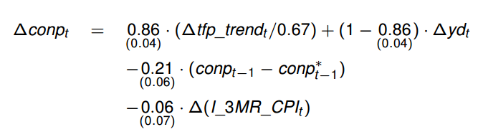
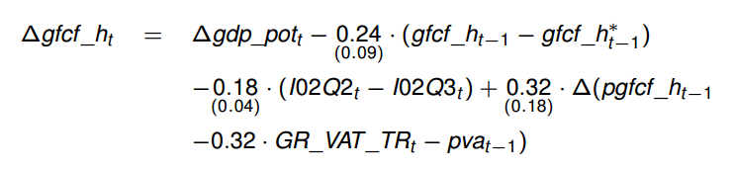
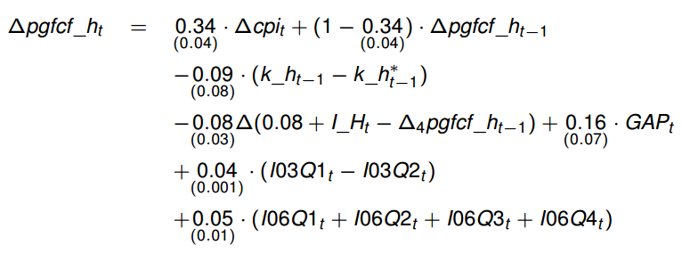
Sectors | Equations | Variables
II. Households’ sector |  | Adjusted R² = 0.08 S.E. of equation = 0.005 LM test (p-value) = 0.1082 Estimation period: 1997q2 - 2008q4 TFP_TREND - trend total factor productivity,
 |  | Adjusted R² = 0.43 S.E. of equation = 0.054 LM test (p-value) = 0.29 Estimation period: 1996q1 - 2008q4
 |  | Adjusted R² = 0.93 S.E. of equation = 0.009 LM test (p-value) = 0.084 Estimation period: 1996q3 - 2008q4
Notes:
In the short run fluctuations of consumption depend on real interests rate and dis- posable income changes. Residential investments in the short run exhibits some degree of inertia. Finally, prices of residential capital depend on the cost of residential capital, consumer and property prices and on the output gap. The latter element allows for higher volatility of housing prices as compared to other prices in the business cycle.
That is all of information about the second sectors.
Let move to third sector: Labour supply

Slide 37
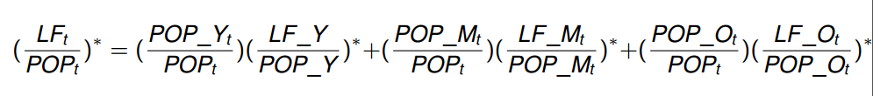
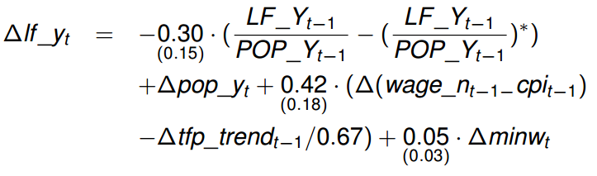
Sector | Equations | Variables
III. Labour supply |  | LF - labour force, POP - total population, LF_Y - force 15-24 years, POP_Y - population 15-24 years, LF_M - labour force 25-44 years, POP_M - population 25-44 years, LF_O - labour force 45+ years, POP_O - population 45+ years,
 | Labour force from 15-24 | Adjusted R² = 0.35 S.E. of equation = 0.01 LM test (p-value) = 0.11 Estimation period: 1996q1 - 2008q4 WAGE_N - nominal gross average wage, CPI - consumer price index, TFP_TREND - trend total factor productivity
Notes:
The approach refers to the discouragement and marginal worker effects, - modelled sepratelly for three different age groups from 15 to 24 years olds, from 25 to 44 years old and from 45 plus (to reflect different factors impinging upon labour activity in each age group), and the participation rate fluctuates with changes in the demographic structure of population of Poland
From that, we can se the short run solution of age groups

Slide 38


Sector | Equations | Variables
III. Labour supply | Labour force from 25-44 | Adjusted R² = 0.69 S.E. of equation = 0.002 LM test (p-value) = 0.013 Estimation period: 1996q1 - 2008q4
 | Labour force from 45+ | Adjusted R² = 0.32 S.E. of equation = 0.007 LM test (p-value) = 0.014 Estimation period: 1996q1 - 2008q4
Notes:
Then let move to the next sector

Slide 39

Sector | Equations | Variables
IV. Labour market |  | WAGE_N - gross nominal average wage in the economy, TFP_TREND - trend total factor productivity, CPI - consumer price index, GR_VAT_TR - effective rate of VAT, W_ENER - weight of energy prices in CPI basket, W_CORE - weight of core inflation in CPI basket, GR_EXT_TR - effective rate of excise duties, GR_GAM_TR - effective rate of gambling taxes, UNRATE - unemployment rate, RR_UNRATE - replacement rate for unemployed (including unemployment benefits), GR_PIT_TR - effective rate of personal income tax, GR_HC_TR - effective rate of compulsory health care contribution, GR_EMP_TR - effective rate of social security contributions paid by employees, GR_CORP_TR - effective rate of social security contributions paid by employers, RR_REM - replacement rate for remittances, POP_Y - population 15-24, POP - total population, MINW - relation of minimum wage to the average gross nominal wage in the economy,
Notes:
Wages are set in the bargaining process between firms and workers. This process is rep- resented by long-run labour demand and supply curves that together with short-term dynamics of labour productivity and the unemployment rate, determine behaviour of wages. You can see here is the equation of wages with variable:
Once evaluated at equilibrium, labour demand and supply uniquely define NAWRU.

Slide 40


Sector | Equations | Variables
IV. Labour market |  | NAWRU - non-accelerating wage inflation rate of unemployment, PVA - value added deflator, DxxQy - shift dummy variable where xx means year and y denotes quarter when the shift takes place, PIMPc -imports prices corrected for the equilibrium exchange rate fluctuations, GR_TAR_TR - effective rate of import duties, EMP_A - employment in agriculture, LF - labour force, KN - net productive capital, TFP_TREND - trend total factor productivity,
 |  | Adjusted R² = 0.74 S.E. of equation = 0.007 LM test (p-value) = 0.001 Estimation period: 1996q1 - 2008q4 ULCNA - unit labour costs in non-agriculture, GDP - gross domestic product, EMP_NA - non-agriculture employment
Notes:
the responsiveness of NAWRU to economic developments over the cycle is mainly determined by labour share in GDP and semi-elasticity of wages with respect to unemployment.
(Phuong trinh t2) In the short-run wages are sticky. Their deviations from the long-term path are as- sociated with the growth rate of labour productivity and changes in unemployment rate. Employment also exhibits certain degree of inertia. Short-run dynamics of employment is also tied to changes in the aggregate demand and real labour costs.

Slide 41




Sector | Equations | Variables
V. External sector | Specification of the external sector is the furthest reaching change in the NECMOD model as compared to its original version. It offers a number of advantages over the former set-up. | GDP_EXP – exports GDP_EXT - foreign GDP (weighted average of GDP in the euro area, the UK, and the USA) GDP - gross domestic product,
 |  | PVA_EXT - foreign value added deflator, S_NEER - nominal effective exchange rate, S_REER - real effective exchange rate, DxxQy - shift dummy variable where xx means year and y denotes quarter when the shift takes place
 |  | PIMP - deflator of imports, PVA - deflator of value-added, GR_TAR_TR - effective rate of import duties
Notes:
The external sector of the model is based on the fundamental equilibrium exchange rate model, where trade integration of the country realtes to the taste-for-variety theory.
Specification of the external sector is the furthest reaching change in the NECMOD model as compared to its original version. It offers a number of advantages over the former set-up. The former specification of the external sector block separated driving forces of observed trend exchange rate appreciation and the progressing integration of the Polish economy.
Export activity is proportionate to the potential product and import intensity to the potential product of trade partners. The attractive feature of the modelling approach is the implied exchange rate appreciation tied to the country's convergence.

Slide 42


Sector | Equations | Variables
V. External sector | Equilibrium exchange rate: | S_REER_EQ - the equilibrium exchange rate, GDP_POT - domestic potential output, GDP_EXT_POT - foreign potential output (weighted average of the potential output in euro area, the UK, and the USA), TCAB - the equilibrium current account to GDP ratio, CAB_TRANS_INC_GDP - ratio of current account income and transfer balances to GDP, OPEN - measure of openness - ratio of imports and exports to GDP, GR_VAT_TR - effective rate of VAT,
 |  | NFA - net foreign assets in PLN, CAB - current account balance (including the capital account) in EUR, S_EUR_PLN - EUR/PLN exchange rate, NFA_GDP - net foreign assets to GDP ratio
Notes:
In the current version of NECMOD, the process of world trade integration is closely tied to GDP level convergence. The equilibrium exchange rate assures stabilisation of foreign assets to GDP ratio at its equilibrium level. And then
The net foreign assets accumulation equation sums up current account balances over periods and explicitly accounts for the valuation effects. The target current account balance is defined as the current account balance consistent with convergence of the net foreign assets to GDP ratio to its steady-state value. It depends on the speed of the net foreign assets convergence and long-run levels of inflation and GDP growth at home and abroad. Accordingly, the equilibrium exchange rate is determined as an exchange rate consistent with the target current account.

Slide 43



Sector | Equations | Variables
V. External sector | Export prices | Adjusted R² = 0.24 S.E. of equation = 0.030 Q test (p-value) = 0.041
 | Import prices | Adjusted R² = 0.27 S.E. of equation = 0.028 Q test (p-value) = 0.041
 | Exchage rate | Adjusted R² = 0.31 S.E. of equation = 0.041 LM test (p-value) = 0.083
Notes:
It is worth noting that properties of the model are such that, in line with medium term appreciation of the Polish zloty, import and export prices decrease in relation to producer prices, while terms-of-trade gradually worsen. Still, to assure that home prices are in the long-run driven solely by the unit labour cost dynamics, trend decline in relative import prices does not impact producer and consumer prices relations which has been achieved via introduction of appropriate adjustment in price equations.
That is all information about External sector.
Now let move to 6 sector.

Slide 44




Sector | Equations | Variables
VI. Aggregate demand and supply |  | GDP - gross domestic product, CONP - individual consumption, CONGOV - government consumption, GFCF - gross fixed capital formation, INV - change in inventories, GDP_EXP - exports, GDP_IMP - imports
 | Nominal gross domestic product | X_N - nominal value of variable X, CPI - consumer price index, PCONGOV - government consumption deflator, PVA - value added deflator, PEXP - export prices, PIMP - import prices,
 | GDP deflator
 | The potential output | GDP_POT - domestic potential output, LF_EQ - the equilibrium participation rate, POP - total population, NAWRU - non-accelerating wage inflation rate of unemployment, KN - net productive capital, TFP_TREND - trend total factor productivity
Notes:
In this sector, GDP deflator is derived as ratio of the nominal to the real product". The potential output is derived from the production function, where effective labour supply is approximated by population corrected for the equilibrium unemployment and the equilibrium participation rate.

Slide 45


Sector | Equations | Variables
VII. Cost and prices | Value added deflator - short run solution | PVA - value added deflator, ULCNA - unit labour costs in non-agriculture, PIMP – imports prices corrected for the equilibrium exchange rate fluctuations, GR_TAR_TR - effective rate of import duties, INF_TARGET - 4-quarter moving average of inflation target, IxxQy - one period dummy variable, where xx denotes year and y stands for quarter. Adjusted R² = 0.45 S.E. of equation = 0.007 J statistic(p-value) = 0.1 Estimation period: 1997q4 - 2008q4
 | Core inflation | Adjusted R² = 0.92 S.E. of equation = 0.003 J statistic(p-value) = 0.1 Estimation period: 1997q4 - 2008q4
Notes:
Price block of the model is based on the cost theory of prices. Core inflation and value- added deflator depend on unit labour costs and import prices. The price block is closed with equations representing food and energy prices that relate home food and energy price inflation to commodity prices in the world markets, as well as overall price level in the domestic market. In the short run, the behaviour of core inflation and the deflator is influenced by inflation expectations (both backward- and forward-looking), short-run unit labour costs and import prices developments.

Slide 46


Sector | Equations | Variables
VIII. Fiscal sector | General government revenues | GR_N - total general government (GG) revenues, GR_PROD_TAX_N - GG revenues from taxes on production and imports, GR_INC_TAX_N - GG revenues from income and wealth taxes, GR_TCONTR_N - total social contributions, GR_PROP_INC_N - GG’s property income, GR_OTHER_CURT_N - GG revenues from other current transfers, GR_OUTPUT_N - GG market output, output for own final use and payments for other non-market output, GR_CAP_TRANS_N - GG revenues from capital transfers,
 | General government expenditures | GE_N - total GG expenditures, GE_RELIEF_KIND_N - GG expenditures on social transfers in kind, GE_SOC_CASH_N – GG expenditures on social benefits other than social transfers in kind, GE_SUB_FARM_N - GG subsidies to farmers, GE_SUB_NOFARM_N GG subsidies excluding subsidies to farmers, GE_OTHER_TRANS_N - other GG transfers without EU budget contribution, GE_EU_N GG contribution to the EU budget, GE_FIN_N - interest on the GG debt, GE_WF_N - GG compensations for employees, GE_CON_N GG intermediate consumption, GE_GFCF_N - nominal GG investments, GE_CAP_TRANS_N - GG capital transfers
Notes:
Both expenditure and revenue side of the fiscal sector are modelled separately at a relatively very detailed level. Here, we will concentrate on differences in comparison with the previous model version.
In the current version of the model social benefits have been divided into more subcategories in order to enrich analysis of the impact of social benefits on the labour market. In the previous version of the model social benefits other than social transfers in kind were divided into expenditures on pensions, unemployment benefit expenditures, and other so- cial relief expenditures. Now the latter has been replaced with its subcomponents - family benefits, preretirement benefits, social insurance benefits, i.e. health, maternity benefits and expenditure on social assistance - e.g. social pensions, housing benefits.
All the four new variables enter the nominal disposable income of households. Apart from social assistance benefits they affect government revenues via personal income tax and compulsory health care contribution. And finally, only family benefits influence social Security contributions paid by employers and employees.

Slide 47





Sector | Equations | Variables
VIII. Fiscal sector | General government balance: | GR_N - total general government (GG) revenues, GE_N - total GG expenditures,
 | General government debt: | G_BALANCE_N - GG balance, G_DEBT_N - GG debt, G_DEBT_DOM_RES_N - GG debt in domestic currency held by residents, G_DEBT_DOM_NRES_N - GG debt in domestic currency held by non-residents, G_DEBT_FOR_RES_N - GG debt in foreign currencies held by residents, G_DEBT_FOR_NRES_N - GG debt in foreign currencies held by non-residents,
 | Total servicing cost of the GG debt: Interest on the GG debt in domestic currency | Interests on the GG debt in foreign currencies: Effective exchange rate relevant for GG debt denominated in foreign currencies:
Notes:
General government debt has been divided into four categories, distinguished by both currency denomination and debt ownership. Each subcomponent of debt is now modelled separately with debt accumulation equation in which corresponding part of current budget deficit adds itself up to the existing stock of debt of a given category (foreign debt accumulation is also affected by changes in the exchange rate)
Cost of debt servicing is modelled for domestic and foreign currency denominated debt separately. Formula for servicing cost of domestic debt takes into account average debt duration, while that for foreign debt is affected by exchange rate movements. Costs of resident and non-resident debt are shared according to the ownership structure.

Slide 48



Sector | Equations | Variables
IX. The monetary authority and interest rates | Money demand | M3 - M3+ monetary aggregate, GDP_N - nominal gross domestic product, S_NEER - nominal effective exchange rate
 | Monetary policy rule: | Adjusted R² = 0.99 S.E. of equation = 0.005 J statistic(p-value) = 0.830 Estimation period: 2000q3 - 2008q3
 | Long term interest rate | I_3M - WIBOR 3M, I_3MR_EQ - the equilibrium interest rate, INF - CPI inflation, INF_TARGET - 4-quarter moving average of inflation target, GAP - output gap, I_5Y - yield on 5-year government bonds,
Notes:
In order to follow the behaviour of the monetary aggregates the money demand function has been introduced. The equation that governs money demand is based on the quantitative theory of money and does not influence other equations of the model. For the modelling perspective M3 has been chosen, as the broadest and the least volatile money aggregate.
It is assumed that in the long run money demand depends on nominal GDP (scale variable) and nominal short and long interests rates spread (between 3 months WIBOR I_3M and 5 years government bonds I 5Y) as a proxy for opportunity cost of holding money. Short-term fluctuations are driven by nominal GDP changes and, nominal exchange rate (S_NEER), as recently many loans are denominated in foreign currencies.

Slide 49
Sector
X. Long-term properties | A few simplifying assumptions are imposed on the long-run dynamics of the key exogenous variables: All foreign nominal variables (commodity price indexes, value-added deflators in Poland's trading partners) grow at a common and constant rate, Growth rate of foreign actual and potential GDP, as wel as TFP growth, is whereas foreign output gap is assumed to be zero, Nominal interest rates abroad are constant, Population of Poland and its age structure are constant, Minimum wage rate is fully indexed to the average wage rate
Notes:
The current model version differs from the version published in 2008 primarily by the endogenisation of variables which have been henceforth assumed to be exogenous and enrichment of the model through the introduction of further linkages between its blocks.
The endogenization mostly concerns current account components, while the latter affects trade, fiscal and household sector variables
(SAU ĐÓ ĐỌC SLIDE)

Slide 50
4.2. NECMOD MODEL _ 2009
4.2.5. Model’s impulse response functions
Monetary impulse
Exchange rate impulse
Notes:
There are many model’s impulse response functions. However the time is limited so I focus on 3 main impulse

Slide 51

4.2. NECMOD MODEL _ 2009
4.2.5. Model’s impulse response functions
Monetary impulse
The monetary impulse is defined as an unexpected one quarter increase in the short-term interest rate by 100 basis points
The interest rate moves in line with the monetary feedback rule → The fiscal rule is switched on.
GDP growth rate, value of households wealth and aggregate demand reduce.
Inflation is further reduced.
Notes:
The monetary impulse is defined as an unexpected one-quarter increase in the short-term interest rate by 100 basis points,
Following the shock, the interest rate moves in line with the monetary feedback rule, staying above the baseline for 12 quarters as an effect of the smoothing mechanism. The fiscal rule is switched on. Impulse response functions of key macrocategories are given.
Monetary policy tightening leads to a reduction in GDP growth rate, with the strongest effects observed in the fourth quarter after the shock. Contraction in economic activity is mainly related to a fall in investment demand and net exports. Contractionary monetary policy effect on private consumption is limited. On the one hand, households postpone consumption and cut on housing expenditure when the real interest rates are higher. Lower housing demand depresses prices and value of households wealth, further aggravating consumption demand. On the other hand, consumption growth is sustained by zloty appreciation that leads to an increase in the value of households wealth via improvement in net foreign assets.
As aggregate demand declines, firms reduce employment and wages to bring down their unit labour costs. Inflation is further reduced by lower growth rate of import prices, driven by domestic currency appreciation. The negative effects of interest rate shock on inflation are strongest in the fifth quarter after the shock.
In response to GDP growth decline and falling rate of inflation, monetary policy stance is eventually reversed as indicated by the Taylor rule. Economic activity restores and inflation increases as the economy converges to the path consistent with the baseline.

Slide 52

4.2. NECMOD MODEL _ 2009
4.2.5. Model’s impulse response functions
(2) Exchange rate impulse
Is an unexpected one-quarter appreciation of the real (and nominal) effective exchange rate of 10%.
Exchange rate appreciation leads to a reduction in import prices and, consequently, to a fall in the core inflation rate.
Food and energy inflation also decrease.
Notes:
The exchange rate impulse is defined as an unexpected one-quarter appreciation of the real (and nominal) effective exchange rate of 10%. The simulation is conducted with both monetary and fiscal policy rules enabled.
Exchange rate appreciation leads to a reduction in import prices and, consequently, to a fall in the core inflation rate. Food and energy inflation also decrease as prices of these commodities traded on the world markets fall when expressed in zlotys.
Concerning the real side of the economy, as domestically produced goods become less competitive, eexports fall while imports increase, and thus negative contribution of net exports depresses output.
Just after the initial shock, exchange rate starts to depreciate converging to its equi- librium path. In the subsequent quarters the process of depreciation is reinforced by reaction of monetary policy (interest rate cuts in response to lower inflation and GDP growth) and widened current account imbalance. Inflation and GDP components growth rates accelerate on their way back to bascline.

Slide 53
4.2. NECMOD MODEL _ 2009
4.2.6 Summary
The BNP’s method in 2009
Advantages and disadvantages

Slide 54
4.2. NECMOD MODEL _ 2009
4.2.6 Summary
The BNP’s method in 2009
It is a more detailed and coherent approach to the modelling of the external sector block.
Secular changes in the exchange rate and foreign trade dynamics are explained- jointly with reference to the taste-for-variety theory.
Reflects better interdependencies between domestic and external sector
Improvement of seasonal adjustment algorithms
Notes:
as compared to the previous version, is a more detailed and coherent approach to the modelling of the external sector block. Now, secular changes in the exchange rate and foreign trade dynamics are explained- jointly with reference to the taste-for-variety theory. Moreover, the current version of the model better reflects interdependencies between domestic and external sector, i.e. via exchange rate - wealth channel
Improvement of seasonal adjustment algorithms

Slide 55
4.2. NECMOD MODEL _ 2009
4.2.6 Summary
(II) Advantages and disadvantages:
Advantages:
Major challenges tackled in the current version of the model.
Closer look was given to coherency of specification of the trade block jointly with the equilibrium exchange rate.
Its explicit treatment of policies (i.e. inflow of structural funds) and phenomena (i.e. stronger inflow of remittances) connected with Polish participation in the European Union.
Offers more promising framework for forecasting in conditions of strong fluctuations of global demand and high medium-run volatility of the exchange rate.
Disadvantage:
The model has been re-estimated in more detail, however it has not yet assessed all the influencing factors.
Notes:
Major challenges tackled in the current version of the model originate in the gradual process of economic convergence and integration of Polish economy into European and global environment,
Compared to the previous model version, closer look was given to coherency of specification of the trade block jointly with the equilibrium exchange rate,
An advantage of the model is its explicit treatment of policies (i.e. inflow of structural funds) and phenomena (i.e. stronger inflow of remittances) connected with Polish participation in the European Union,
Current version of the model has not only better simulation properties but also offers more promising framework for forecasting in conditions of strong fluctuations of global demand and high medium-run volatility of the exchange rate

Slide 56
4.III. NECMOD MODEL _ 2010
4.III.1 Overview
4.III.2. Changes in the NECMOD model
4.III.3 Main blocks of NECMOD model
4.III.4. Equations
4.III.5 Model’s impulse response functions
4.III.6 Summary

Slide 57
4.II. NECMOD MODEL _ 2010
4.II1.1 Overview
In 2008, the most important changes included: the extension of the labour market component, the introduction of forward-looking expectations to the model, the disaggregation of investments and accounting for the impact of world market prices on domestic prices
In 2009, the most important modification implemented was the change in the specification of the foreign trade block.
In 2010, the scale of changes was relatively smaller and focused on modifications in the price equations
Data:
Changes, as compared to the previous version of the model, result from the extension of the re-estimation sample (including the year 2009), as well as from the modifications introduced to certain blocks of the model.

Slide 58
4.1II. NECMOD MODEL _ 2010
4.III.2. Changes in the NECMOD model
Deflators of gross value added and core inflation: In this version of the model, the block of prices is based on the concept used in the model of Banco de Espana (Estrada et al. 2004; Ortego et al. 2007).
Equation of corporate gross fixed capital formation: the definition of the marginal product of capital was changed. Now, it is determined on the basis of current rather than potential GDP. Whereas, the marginal product of labour is determined accounting for the adjustment of the total employment to the current level of production
Equations of energy and food prices: In the new version, the gross value added deflator is used as a measure of domestic prices, instead of core inflation, which is a narrower category.
Changed definition of capital: the new specification of the model displays a lower inertia of productive capital (and potential output) in the cycle.
Disaggregation of consumption: each type of consumption is modeled separately, not in the same equation as before.

Slide 59
4.III. NECMOD MODEL _ 2010
4.III.3. Main blocks of NECMOD model
NECMOD_2010
1.Production
2. Demand
3. Labour
4. Household expenditure
5. Prices
6. External
7. Interest rate
1.1. GDP
1.2. Corporate capital
7.1. Long - term
7.2. Short - term
2.1. Private investment
2.2. Demand on labour
6.1. Exports
6.2. Imports
6.3. Nominal exchange rate
3.1. Economic activity
3.2. Supply of loan
3.3. Wage
3.4. Unemployment rate
5.1. Prices
5.2. Deflation
4.1. Individual consumption
4.2. Residential investment
4.3. Assets deflator
Main blocks of NECMOD model have not changed with previous versions. There is only change in the details of the prices block (New corporate investment equation.

Slide 60




4.III. NECMOD MODEL _ 2010
4.III.4. Equations
Sector | Equations | Variables and Changes in the model
V. Prices 1,Producer prices depends on value added deflator (it is main index of producer prices). 2, Equation of corporate gross fixed capital formation: | 2009 | GR_TAR_TR: effective rate of import duties PVA: value added deflator TREND: trend PIMP – prices of imported goods The block of prices is based on the concept used in the model of Banco de Espana. Current unit labour costs have been changed for unit labour costs determined for the level of employment adjusted to the current output leve Both approaches, produce the same long-term solution. However, the short-run behaviour of prices is different in these two equations.
 | 2010
 | 2009 | MPC –marginal product of private capital, RUCC - real user cost of capital MPL –marginal product of labour. RUCL - real user cost of labour. In the new version, the corporate investment demand increases if the ratio of the marginal product of capital to the marginal product of labour is higher than the corresponding relation of their real costs
 | 2010

Slide 61




Sector | Equations | Variables and Changes in the model
V. Prices 3, Food and energy products prices are adjusted by experts in the projection horizon 4, Disaggregation of consumption | 2009 | enercpi: enerdy product price index p_ener: world raw energy commodities price index GR_EXT_REST_TR: effective exercise tax rate-other goods GR_EXT_ENER_TR: effective excise tax rate – energy products
 | 2010 | The gross value added deflator is used as a measure of domestic prices, instead of core inflation, which is a narrower category. Because, after the accession to the EU, the energy prices were rising faster than it was expected from analyzing cost determinant
 | 2009 | each type of consumption is modeled separately from before there was only one model.
 | 2010

Slide 62
4.III. NECMOD MODEL _ 2010
4.III.5. Model’s impulse response functions
Analysis of the effects of changes in external prices
Analysis of the effects of EU funds inflow

Slide 63

4.III. NECMOD MODEL _ 2010
4.III.5. Model’s impulse response functions
Analysis of the effects of changes in external prices
The increase in energy commodity prices leads directly to a higher growth rate of import prices and energy prices in the domestic market. The trade balance deterioration, caused by less favourable terms of trade, translates into weakening of the equilibrium exchange rate and, consequently, lower current exchange rate.
Enterprises incur additional costs associated with rising energy prices and higher credit costs, which curbs their investments, and translates, with some delay, into decline of productive capital. This leads to a reduction in the level of potential output and wealth. Wealth is further reduced by the depreciation of the exchange rate, which affects the level of net foreign assets

Slide 64

4.III. NECMOD MODEL _ 2010
4.III.5. Model’s impulse response functions
(2) Analysis of the effects of EU funds inflow
Higher public investment, due to its low import intensity, significantly increase the demand for domestic goods, which translates into faster GDP growth. On the other hand, the inflow of EU funds improves the current account balance, which leads to the strengthening of the zloty exchange rate. The stronger zloty reduces exports and increases imports, adversely affecting GDP growth.
In the short term, the inflow of EU funds raises demand in the economy, pushing CPI inflation up. The opposite influence is exerted by the appreciation of the exchange rate leading to a decline in import prices, including food prices expressed in domestic currency, which leads to the reduction in core inflation and food price inflation.

Slide 65
4.III. NECMOD MODEL _ 2010
4.III.6 Summary
NECMOD Model_2010 mainly presents the changes in the price equation, new corporate investment equation and capital definition used in the model compared with the previous models.
In the current version of the model the definition of capital has been changed from gross capital to net capital, what is consistent with national accounts.
Net capital assumes lower values than gross capital, and therefore, investments more strongly affect the relative change in net capital than that in gross capital. Consequently, the new specification of the model displays a lower inertia of productive capital (and potential output) in the cycle.

Slide 66
4.IV. NECMOD MODEL _ 2011
4.IV.1 Overview
4.IV.2. Changes in the NECMOD model
4.IV.3 Main blocks of NECMOD model
4.IV.4 Model’s impulse response functions
4.IV.5 Summary

Slide 67
4.IV. NECMOD MODEL _ 2011
4.IV.1 Overview
In 2008, the most important changes included: the extension of the labour market component, the introduction of forward-looking expectations to the model, the disaggregation of investments and accounting for the impact of world market prices on domestic prices
In 2009, the most important modification implemented was the change in the specification of the foreign trade block.
In 2010 and 2011, the scale of changes focused on modifications in the price equations (New corporate investment equation in 2010 and including the hysteresis in 2011).
Data:
Changes, as compared to the previous version of the model, result from the extension of the re-estimation sample (including the year 2010), as well as from the modifications introduced to certain blocks of the model.

Slide 68
4.IV. NECMOD MODEL _ 2011
4.IV.2. Changes in the NECMOD model
Domestic energy prices: domestic energy prices are dependent, apart from other variables, on global index of energy commodity prices, which is a weighted average of hard coal, crude oil and natural gas prices. The equation was modified to diversify the speed of the impact, that changes of certain commodities prices have on domestic energy prices.
Re-estimation of the short-term exchange rate equation: Sarno and Valente (2009) claim that information derived from the fundamentals may provide an explanation for a large part of changes in the exchange rate, yet it is not possible to choose a model ex ante. The reason is the behavior of the exchange rate which, in the short-term, is close to the random walk process; moreover, factors influencing exchange rate developments change over time
Impact of indirect taxes on prices: In short-term equations of core inflation, energy prices and food prices, parameters were calibrated, given effective rates of indirect taxes, on the basis of an estimated pass-through of changes in VAT rates into consumer prices after January 1, 2011.
Accounting for hysteresis effects: An OECD study (2009) shows that a 1% rise in unemployment rates feeds through, in the longer term, into a 0.7% increase in the equilibrium unemployment rate. This phenomenon has not been so far fully incorporated into the NECMOD model

Slide 69
4.IV. NECMOD MODEL _ 2011
4.IV.2. Changes in the NECMOD model
Change in the external sector weights: The pace of recovery of the German economy (Poland’s main trading partner) largely exceeds the one observed in France or Spain. During the model re-estimation, the euro area was divided into Germany and other euro area countries. Thus, Germany’s weight in the external sector of the model increased.
Change in the breakdown of the economically active population: . In the present version of the NECMOD model, the participation rate is modeled in four age groups. In the new version of the model, as compared to the previous version, population aged 45 years and older was divided into two age groups: 45-59/64 years and 60/65 years and more
Revision of the TFP estimate: During the model re-estimation, TFP level was re-estimated using the guidelines of the European Commission under which HP filter used to smooth TFP series is extended by information contained in additional variables (i.e. production capacity utilization) (European Commission, 2008, 2009)

Slide 70
4.IV. NECMOD MODEL _ 2011
4.IV.3. Main blocks of NECMOD model
NECMOD_2011
1.Production
2. Demand
3. Labour
4. Household expenditure
5. Prices
6. External
7. Interest rate
1.1. GDP
1.2. Corporate capital
7.1. Long - term
7.2. Short - term
2.1. Private investment
2.2. Demand on labour
6.1. Exports
6.2. Imports
6.3. Nominal exchange rate
3.1. Economic activity
3.2. Supply of loan
3.3. Wage
3.4. Unemployment rate
5.1. Prices
5.2. Deflation
4.1. Individual consumption
4.2. Residential investment
4.3. Assets deflator
Main blocks of NECMOD model have not changed with previous versions (2010). ( Just add including the hysteresis as mentioned above).

Slide 71
4.IV. NECMOD MODEL _ 2011
4.IV.4. Model’s impulse response functions
Impulse of changes in agricultural commodity prices
Analysis of the effects of higher VAT rate

Slide 72

4.IV. NECMOD MODEL _ 2011
4.IV.4. Model’s impulse response functions
Impulse of changes in agricultural commodity prices
The rise in agricultural commodity prices abroad translates into higher domestic prices of these commodities. This leads to growing domestic food prices (CPI component) - in the third quarter after the impulse by slightly over 2 percent, which means a rise in CPI inflation by approx. 0.5 percentage points
The rise in agricultural commodity prices has also resulted in a decline in GDP growth. Higher interest rates affect the decisions of households and enterprises by curbing consumption, investment and inventories. Higher interest rates are also a factor behind exchange rate appreciation which results in lower exports and higher imports.

Slide 73

4.IV. NECMOD MODEL _ 2011
4.IV.4. Model’s impulse response functions
(2) Analysis of the effects of higher VAT rate
Increased VAT income in the short term will improve the public sector balance by approx. 0.3 percent of GDP, at the same time, boosting inflation and curbing GDP growth. Rising tax burden translates partly into higher consumer prices (inflation growth in the first year of 0.3 percentage points), and partly is taken over by producers, which is conducive, in turn, to diminishing households income from operating surplus.
In the longer term horizon, lower economic growth translates into a deterioration in the labour market and further decline in real wage fund and private consumption. Unfavourable situation in the labour market and limited demand brings inflation in the medium term below the base scenario

Slide 74
4.IV.NECMOD MODEL _ 2011
4.IV.5 Summary
NECMOD Model_2011 mainly presents the changes to price block ( Including the hysteresis). The main blocks of NECMOD model_2011 are similar to 2010 as described above.
More specifically, the model includes some changes related to domestic energy prices, short-term exchange rate, impact of indirect taxes, external sector weights, breakdown of the economic prices active population and TFP estimate

Slide 75
4.5. NECMOD MODEL _ 2012
4.1.1. Overview
4.1.2. Changes in the model
4.1.3. The NECMOD model
4.1.4. Main blocks of NECMOD model
4.1.5. Equations
4.1.6. Model’s impulse response functions
4.1.7. Summary
Notes:
In 2012, the economic activity block was re-specified
to ensure stronger impact of legal changes limiting the number of persons eligible for
retirement pay on the number of economically active persons.

Slide 76
4.1. NECMOD MODEL _ 2012
4.1.1 Overview
- During re-estimation rounds in 2010 and 2011 changes focused on modifications in price equations.
In 2012, the economic activity block was re-specified to ensure stronger impact of legal changes limiting the number of persons eligible for retirement pay on the number of economically active persons.
The model distinguishes three types of investment, modeled separately: residential, corporate and public investment.
Data:
Main source: national accounts
Information about labour market (LFS data), prices of consumer goods (CPI basket), financial data from BNP

Slide 77
4.1. NECMOD MODEL _ 2012
4.1.2. Changes in the model
As compared to the previous re-estimation rounds, the extent of modifications introduced to the model was minor – in fact, it was limited to two modifications referred to below.
Re-specification of the economic activity block
to ensure stronger, translation of legal changes limiting the number of persons eligible for retirement pay into the number of the economically active persons.
Stronger translation of the situation abroad into domestic economy
external economic activity affects domestic economic activity have been added
adding variables reflecting business conditions abroad

Slide 78
4.1. NECMOD MODEL _ 2012
4.1.3. The NECMOD model
NECMOD model has 276 equations and 369 variables

Slide 79
4.1. NECMOD MODEL _ 2012
4.1.3. Main blocks of NECMOD model
NECMOD_2012
1. Prices
2. Labour
3. External
4. Household expenditure
5. Interest rate
6.Accumulation
5.1. Core inflation
5.2. Deflation
5.3 Inflation
6.1 Corporate capital formation
3.1. Employment
3.2. Participation rates
3.3. Wage
7.1. Long - term
7.2. Short - term
6.1. Exports
6.2. Imports
6.3. Deflator of exports/imports
6.4. Real effective exchange rate
4.1. Individual consumption
4.2. Residential investment
4.3. Deflator

Slide 80




4.1.4. NECMOD MODEL _ 2012
Sectors | Equations | Variables
1.Prices | Core inflation | C_CORE (EX) – time-varying constant in core inflation equation GR CORE TR (EN) – effective rate of taxes imposed on prices of goods and services which are in the core inflation basket
 | Deflator of value-added | C PVA (EX) – time-varying constant in value added equation GR CORP TR (EN) – effective rate of social security contributions paid by employers
 | Inflation of energy prices | GR ENER TR (EN) – effective rate of taxes imposed on energy prices GR CO2 ENER TR (EN) – effective rate of charges imposed on energy prices connected with costs of purchasing CO2 emission rights
 | Inflation of food prices | C_FOOD (EX) – time-varying constant in food prices inflation equation GR VAT TR (EN) – effective rate of VAT

Slide 81




Sectors | Equations
II. Labour market | Employment: | Estimation period: 1997q1 - 2011q4
 | Participation rate net of persons eligible for pension benefits and persons pursuing full-time studies aged 15-24 | Participation rate for population aged 15-24 net of persons eligible for pension benefits and persons pursuing full-time studies
 | Participation rate for population aged 25-44 net of persons eligible for pension benefits | Participation rate for population aged 45-59/64 net of persons eligible for pension benefits

Slide 82


Sector | Equations | Variables
II. Labour market | Participation rate for population aged 60/65+ net of persons eligible for pension benefits | LF PW (EN) – post-production labour force (60/65+ years) LF PW RET (EN) – number of the economically active persons aged 60/65+, eligible, at the same time, for pension benefits LF PW (EN) – post-production labour force (60/65+ years) LF PW RET (EN) – number of the economically active persons aged 60/65+, eligible, at the same time, for pension benefits
 | Wages | UNRATE (EN) – unemployment rate UNRATE AVER (EN) – long-lasting unemployment rate – geometrical average of unemployment rate multiplied by 0.74 RR UNEMP (EN) – replacement rate for unemployed (including unemployment benefits and social relief)

Slide 83




Sector | Equations
III. Foreign trade | Exports volume | Deflator of exports
 | Imports volume | Deflator of imports

Slide 84

Sector | Equations | Variables
III. Foreign trade | Real effective exchange rate | TCAB (EN) – the equilibrium current account to GDP ratio CAB TRANS INC GDP (EN) – ratio of current account income and transfer balances to GDP CONP (EN) – individual consumption GFCF P (EN) – gross fixed corporate capital formation DD (EN) – domestic demand INV (EN) – change in inventories

Slide 85




Sector | Equations
IV. Households’ sector | Individual consumption of durable goods | Individual consumption of non-durable goods and services
 | Gross fixed residential capital formation | M3 (EN) – money supply, M3 monetary aggregate HH NET WEALTH RATIO (EN) – variable reflecting changes in households’ assets and liabilities as compared to their wealth I 3MR CPI (EN) – real 3-month interest rate (deflated with CPI) GR VAT TR (EN) – effective rate of VAT INF TARGET (EX) – inflation target
 | Deflator of gross fixed residential capital formation | RUCC H (EN) – real user cost of residential capital UNRATE (EN) – unemployment rate INF TARGET (EX) – inflation target

Slide 86


Sector | Equations | Variables
V. Interest rates | WIBOR 3M quarterly average | I 3M (EN) – WIBOR 3M quarterly average I 3MR EQ (EX) – equilibrium real interest rate INF TARGET (EX) – smoothed inflation target (four-quarter moving average)
 | Yield on 5-year government bonds | I_5Y (EN) – yield on 5-year government bonds G BALANCE GDP (EN) – General Government balance to GDP ratio

Slide 87


 | Equations | Variables
VI. Accumulation | Gross fixed corporate capital formation | MPC (EN) - marginal product of corporate capital 29 MPL (EN) - marginal product of labour after adjusting for current GDP RUCC (EN) – real user cost of capital RUCL (EN) - real cost of labour

Slide 88
4.1. NECMOD MODEL _ 2012
4.1.4. Model’s impulse response functions
Monetary impulse
Exchange rate impulse

Slide 89

4.1. NECMOD MODEL _ 2012
4.1.4. Model’s impulse response functions
Monetary impulse
increase in the short-term interest rates
increase in costs of raising capital
reduces both corporate and household investment
a drop in housing prices, the decline in household assets reducing consumer demand
GDP growth falls by about 0.53 percentage points
Consequently, CPI inflation falls by about 0.41 percentage points 4 quarters after the increase in interest rate.

Slide 90

4.1. NECMOD MODEL _ 2012
4.1.4. Model’s impulse response functions
(2) Exchange rate impulse
decline in import prices and in all the components of CPI inflation
Domestic products become less competitive abroad
In total, interest rate fluctuations lead to deterioration in net exports’ contribution to GDP
a deterioration in the labour market situation
a reduction of disposable income of households and a consumption decline
In response to falling prices and lower economic growth, monetary policy is being relaxed, supporting the economy in its return to the equilibrium state.

Slide 91
4.1. NECMOD MODEL 2012
4.1.6 Summary
As compared to the previous re-estimation rounds, the extent of modifications introduced to the model was minor – in fact, it was limited to two modifications.
During re-estimation rounds in 2010 and 2011 changes focused on modifications in price equations
In 2012, the economic activity block was re-specified to ensure stronger impact of legal changes limiting the number of persons eligible for retirement pay on the number of economically active persons.

Slide 92
V. Conclusion
NECMOD, which was developed foremost to facilitate implementation of the monetary policy in Poland through a regular delivery of inflation and GDP projections.
The model encompasses all major channels of the monetary policy transmission mechanism and is able to deliver a comprehensive account of factors underlying the main economic developments
NECMOD is able to describe propagation of a range of macroeconomic shocks
reflect the dynamic nature of a converging economy
The re-estimation of the NECMOD model is carried out once a year, before the July projection round – the last one took place in May 2019.
Last update in 2012

Slide 93
Thank YOU FOR YOUR ATTENTION !!!
DSGE MODEL for National Bank of Poland
Content by:
1. Le Thi Ngoc
2. Nguyen Thi Kim Phuong
3. Trinh Ngo MinhTruong
4. Nguyen Tu Anh
REFERENCE:
https://www.nbp.pl/homen.aspx?f=/en/publikacje/raport_inflacja/necmod.html

Slide 94


